Slide 1


Ghoroub Bostagi
2000910
Maryam Alamoudi 2000404
Sumayya Azzony 2001768

Slide 2
Project Idea
Training Management Platform
This project aims to develop a web-based application that allows users to accomplish different tasks.
Administrators should be able to schedule training sessions, invite trainers and trainees, and send reminders.
Trainees, on the other hand, should be able to register themselves in a given session, request attendance statements. Both types of users should be able to generate relevant reports.

Slide 3

Programmer Academy Website
Programming Academy is a website that provide many different programming courses to help anyone to learn how to code in many different programming languages by top instructors.

Slide 4

Requirements
We have two type of users:
Administrator.
Administrator can:
Add a new course.
Invite the trainees to the courses.
Send reminder to trainees.
Trainee:
Trainee can:
Register on the website.
Enroll in available courses.

Slide 5
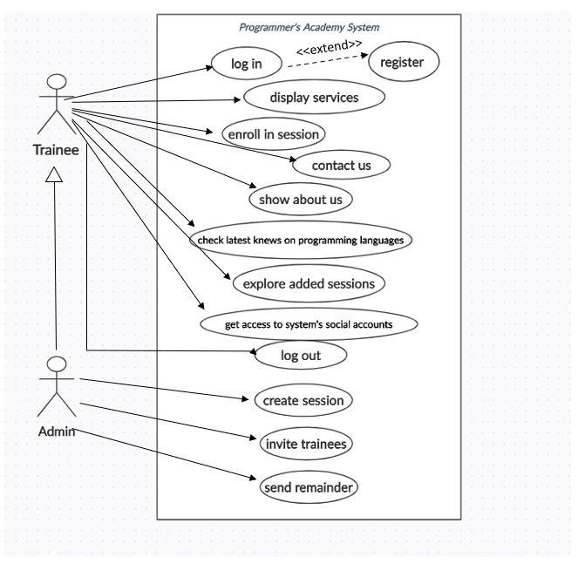
use case diagram for Programmer's academy system

Slide 6



Technical Tools
Atom
Node.js
Mongodb
EJS
Template from:
www.free-css.com
The languages:
HTML and CSS
Java Script and jQuery
Chrome
GitHub

Slide 7

The pages of the website
Home page
About Us
Services
Register
Sign In
Contacts
All Courses
App.js
Programming Languages
Trainee
Trainer
User Profile
Create session
Invite
Admin

Slide 8



Database
Database name: academydb
Session Schema :
sname: String,
stitle: String,
instructor: String,
instructor_email: String ,
sdate: String,
temails: [String]
Trainee Schema :
role: String,
sessions: [SessionSchema]
username: String,
email: String,
pw: String,

Slide 9
future work
The web system can:
print report and
user has a profile page

